Slide 1
9. Continuous Bayes’ rule, Derived Random Variables
ENGG 2760A / ESTR 2018: Probability for Engineers
Fall 2020

Slide 2

Independence
X and Y are independent if
f_{XY}(x, y) = f_{X}(x) f_{Y}(y) for all x, y
if and only if
E[g(X)h(Y)] = E[g(X)]E[h(Y)] for all g, h

Slide 3

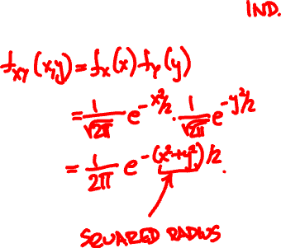
Independent Normals
X, Y are Normal(0, 1)

Slide 4
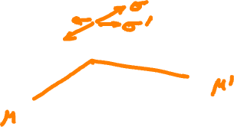
Independent Normals
X is Normal(μ, σ), Y is Normal(μ’, σ’)

Slide 5
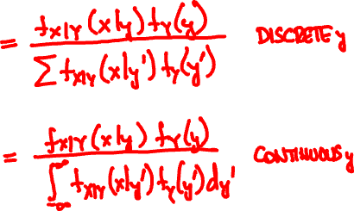
Continuous Bayes’ rule
f_{X|Y}(x | y) f_{Y}(y)
f_{Y | X}(y | x) =
f_{X}(x)

Slide 6


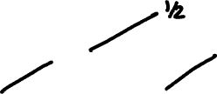
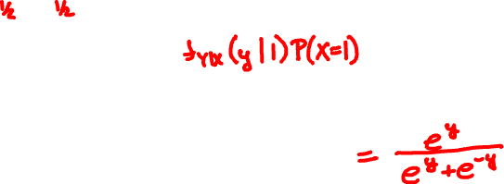
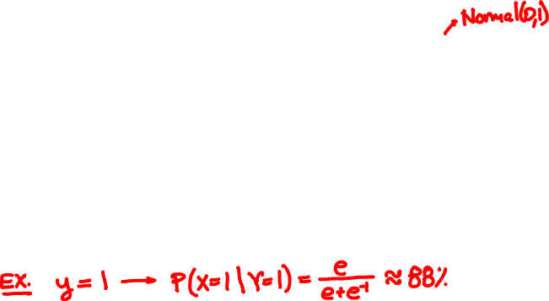

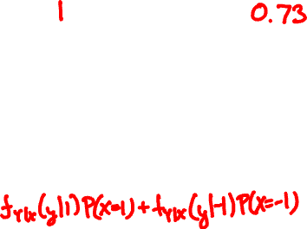
X = 1 or -1
Y = X + N
P(X = 1 | Y = y) =

Slide 7

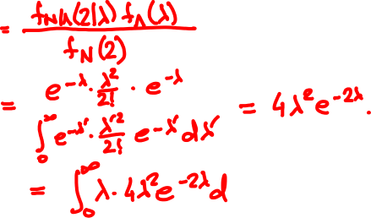


Rain falls at Poisson(Λ) drops/sec
Λ itself is Exponential(1)
You’re hit by 2 drops. What is your guess for Λ?
https://www.symbolab.com/solver/integral-calculator

Slide 8
X is Uniform(0, 1). What is the PDF of Y = √X?

Slide 9
🚙
V = 50 Exponential(1) km/h
50km
0km
What is the PDF of the travel time?

Slide 10
Shifting and scaling
Y = aX + b

Slide 11
Normalization
X is Normal(μ, σ)
Y = (X – μ)/σ

Slide 12
What is the PDF of the loser?

Slide 13
X, Y are independent Uniform(0, 1).
What is the PDF of Y/X?

Slide 14
Convolution
X, Y are independent. What is the PMF/PDF of X + Y?

Slide 15
Toss two 3-sided dice.
What is the sum of face values?

Slide 16
Romeo and Juliet arrive in Shatin at independent Exponential(1) hours past noon.
How long is the wait?

Slide 17
Sum of Independent Normals

Slide 18
Sum of Independent Normals

